Slide 1
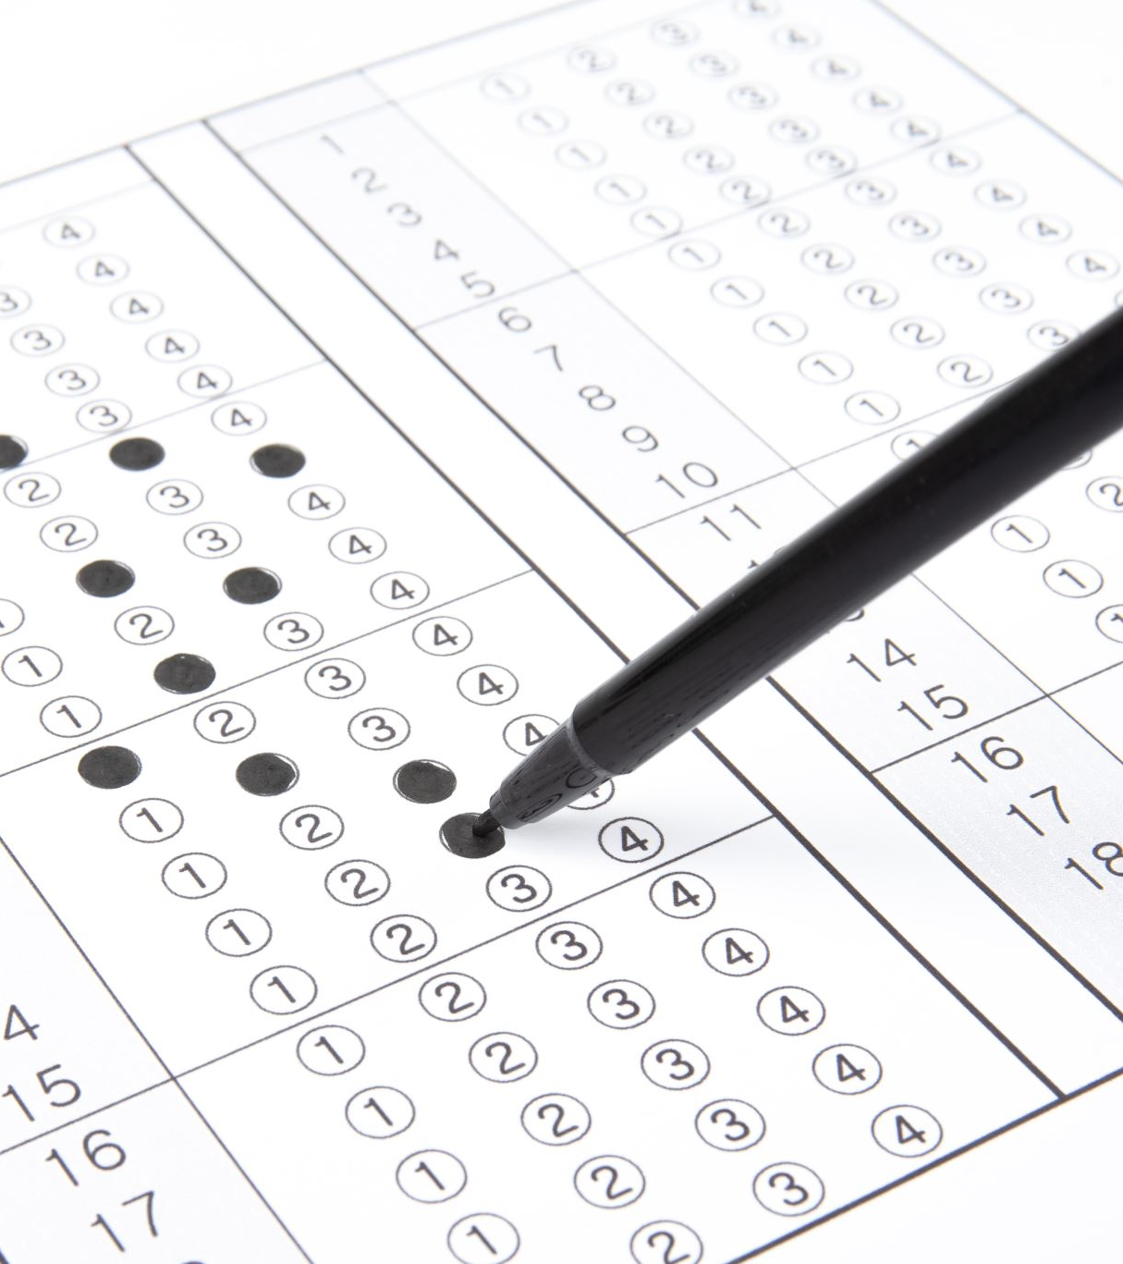
Peer Evaluation Form
Project Title: Movie Recommendation System leveraging Artificial Intelligence Techniques
Team Member Information:
Your Name: Sri Kalyan Reddy Akiti
Team Member Being Evaluated: Pranav Pratheek Malleboyina

Slide 2
Evaluation Criteria
Please rate each of the criteria listed below on a scale from 1 to 5 (1 = Poor, 5 = Excellent). Provide additional comments where necessary to justify your scores.
1.) Contribution to the Project: How actively did the team member contribute to the project's development?
Rating (1-5): 4
Comments: Pranav was active student
2.) Technical Skills & Problem-Solving: How effective was the team member in solving technical challenges, applying concepts, and implementing the solution?
Rating (1-5): 4
Comments: He was good
3.) Team Collaboration: How well did the team member collaborate with other team members during the course of the project?
Rating (1-5): 4
Comments: he is active in collaboration and we shared out intel 4.) Communication: How effectively did the team member communicate ideas, progress, and challenges?
Rating (1-5): 4 Comments: We were doing good.

Slide 3
5.) Timeliness & Responsibility: Did the team member meet deadlines and take ownership of their assigned tasks?
Rating (1-5): 4
Comments: did his work 6.) Quality of Work: How would you rate the quality of the team member's work (code quality, attention to detail, documentation, etc.)?
Rating (1-5): 4
Comments: As a teammate he not only did his work also gave suggestions to improve the model and to make the end to end project
Overall Remarks
Pranav is an extraordinarily focused individual with a keen eye for detail and consistently demonstrates a strong ability to convert ideas into solid solutions. His technical hands-on experience, combined with cause-oriented mindset, helps him tackle challenges efficiently and finish in stipulated time. Pranav is also an exceptional team player who personalizes discussions for strategy, tracking, and defining the deliverables without compromising quality. At times, he goes into deep details, but is flexible to adapt when the bigger picture is involved. Altogether, he has talent, commitment, and teamwork. It gains value for his team and will be a pleasure to work with him again.

